Slide 1
Chapter 7 System software 7.1 Operating Systems

Slide 2
Objectives
Describe why a computer system requires an operating system
Explain the key主要 management tasks carried out实施 by the operating system

Slide 3
1. components of a computer system
Comupter systems
software
System software
Application software
hardware
Utility programs(RGP56)
Library programs
Language
Translators
Operating system
Compiler
Assemblers
interpreters

Slide 4
Application software
The application software corresponds to the system software, is a variety of programming languages that users can use, and a collection of applications compiled in various programming languages, divided into application software packages and user programs.
QQ、Chrome

Slide 5
Utility programs公用程序
A utility program, also called a utility, is a type of system software that performs a specific task, usually related to managing a computer, its devices, or its programs. Most operating systems include several utility programs.
Examples: please see next ppt and P82 in the course book

Slide 6
Library programs(库程序):
An ordered collection of information about various standard programs, subroutines(子例行程序), files, and their directories.
There is no advantage to a programmer in 'reinventing the wheel'. If a routine例行程序 exists in a library a programmer would be very unwise to write his or her own routine. Existing library routines will have been extensively tested before release.
The most obvious examples of library routines are the built-in functions available for use when programming in a particular language.

Slide 7
Compiler: First compile and then execute
Interpreters: Execute while explaining
Assemblers: A program that translates assembly language into machine language

Slide 8
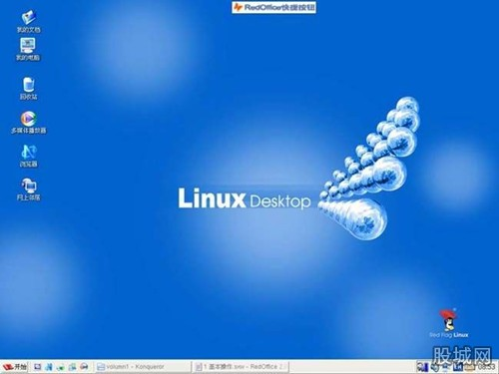
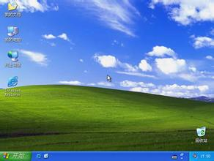
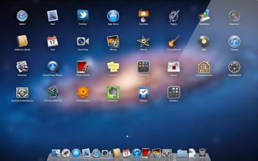
2. Operating system software
Operating system – a software that provides an environment within which programs can be run that are of benefit to a user.

Slide 9
Why a computer system requires an operating system
Any other software must be supported by the operating system to run
The capacity(容量) of the software itself can be reduced
Reduced hardware usage
User‘s operation method can also be unified(统一)

Slide 10
User-system interface
Command-line interface界面(CLI)
Graphical user interface(GUI)
Provide the mechanism(机制) for the execution of the developed program
Programmers write software, users run it, and software USES hardware. Program development tools allow programmers to write programs without knowing the details of what the hardware actually does. The operating system then enables the program to execute on the hardware.
Program-hardware interface

Slide 11
Resource management
Scheduling of processes进程的调度
Resolution of conflicts解决冲突 when two processes require the same resource
Memory protection
Memory organization
Memory usage optimisation内存使用优化
Memory management

Slide 12
Device management
Installation of the appropriate device driver software
Control the usage of devices required by different processes
File naming conventions(约定)
Directory structures
Access control mechanisms访问控制机制
File management

Slide 13
Security management
Provision提供 for recovery when data is lost
Prevention预防 of intrusion入侵
Ensuring确保 data privacy私密
Installs printer driver
Sends data to the printer buffer to print
Sends commands to printer
Printer management

Slide 14
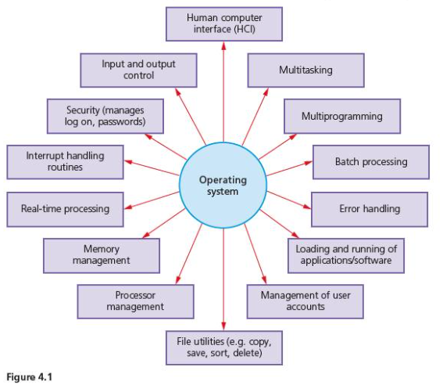

Slide 15
1. components of a computer system
Comupter systems
software
System software
Application software
hardware
Utility programs(RGP56)
Library programs
Language
Translators
Operating system
Compiler
Assemblers
interpreters

